Slide 1
CG2271 lab Overview

Slide 2
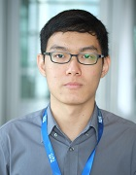
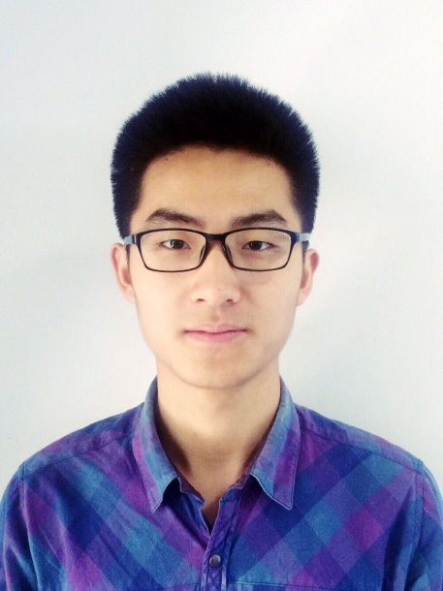
Who are We?
Yun Peng (you may call me YP)
CEG 4 student
Email: yunpeng.chong@u.nus.edu
Phone: 98785082
Xinyu Chen
Ph.D. student
Email: e0204958@u.nus.edu
Phone: 98922932
We encourage questions in the IVLE Forums

Slide 3
Lab Schedule
Lab | Week | Topic | Weightage (%)
1 | 3 4 | Introduction | 3
2 | 5 6 | I/O and Interrupts | 6
3 | 7 8 | Task Management | 8
4 | 9 (Deepavali) 10 | RTOS scheduling | 8
5 | 11 12 | Synchronization and Communication | 10
 | 13 | Assessment for lab 5

Slide 4
Lab Schedule
Each lab spans over 2 weeks
Report are due on the Friday of the second week
E.g. Lab 2 report due on Week 6 Fri 2359
Demo is done at the start of the next lab
E.g. Lab 2 demo is done on Week 7 Wed
The second week of each lab optional (other than Lab 4)
E.g. Lab on week 6 is optional

Slide 5
Assessment for each lab
Report
Correctness of answers to question booklet
Correctness of code (You will be asked to paste your code in the report)
Demo
Correctness of behaviour
Correctness of verbal response to questions asked (individual component)

Slide 6
CG2271 lab 1

Slide 7
Goals
Introduce the Arduino platform
Setting up the IDE for future labs

Slide 8
Study Materials
Manual for Lab 1 – Introduction to Arduino
[recommend] "Tutorial for Arduino" by Jeremy Blum, https://www.youtube.com/watch?v=fCxzA9_kg6s
Tutorials 1-2

Slide 9
Assessment
3% of total grade
No report
Demo at the start of lab 2 (Week 5, 13 Sept)
Lab next week (week 4) is optional

Slide 10
Any Questions?
We encourage questions in the IVLE Forums ☺

